Slide 1
k-Anonymity and
Other Cluster-Based Methods
CS 380S
Vitaly Shmatikov
slide <number>

Slide 2
Reading Assignment
Li, Li, Venkatasubramanian. “t-Closeness: Privacy Beyond k-Anonymity and l-Diversity” (ICDE 2007).
slide <number>

Slide 3
Background
Large amount of person-specific data has been collected in recent years
  Both by governments and by private entities
Data and knowledge extracted by data mining techniques represent a key asset to the society
  Analyzing trends and patterns.
  Formulating public policies
Laws and regulations require that some collected data must be made public
  For example, Census data
slide <number>

Slide 4
Public Data Conundrum
Health-care datasets
  Clinical studies, hospital discharge databases …
Genetic datasets
  $1000 genome, HapMap, deCode …
Demographic datasets
  U.S. Census Bureau, sociology studies …
Search logs, recommender systems, social networks, blogs …
  AOL search data, social networks of blogging sites, Netflix movie ratings, Amazon …
slide <number>

Slide 5
What About Privacy?
First thought: anonymize the data
How?
Remove “personally identifying information” (PII)
  Name, Social Security number, phone number, email, address… what else?
  Anything that identifies the person directly
Is this enough?
slide <number>

Slide 6
Re-identification by Linking
Microdata
Voter registration data
ID
Name
Alice
Betty
Charles
David
Emily
Fred
QID |  |  | SA
Zipcode | Age | Sex | Disease
47677 | 29 | F | Ovarian Cancer
47602 | 22 | F | Ovarian Cancer
47678 | 27 | M | Prostate Cancer
47905 | 43 | M | Flu
47909 | 52 | F | Heart Disease
47906 | 47 | M | Heart Disease
Name | Zipcode | Age | Sex
Alice | 47677 | 29 | F
Bob | 47983 | 65 | M
Carol | 47677 | 22 | F
Dan | 47532 | 23 | M
Ellen | 46789 | 43 | F
slide <number>

Slide 7
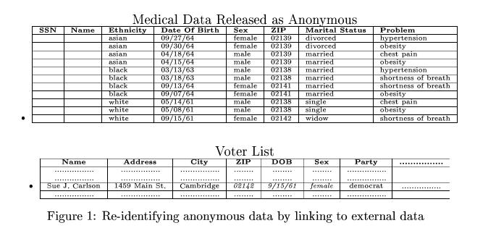
Latanya Sweeney’s Attack (1997)
Massachusetts hospital discharge dataset
Public voter dataset
slide <number>

Slide 8
Quasi-Identifiers
Key attributes
  Name, address, phone number - uniquely identifying!
  Always removed before release
Quasi-identifiers
  (5-digit ZIP code, birth date, gender) uniquely identify 87% of the population in the U.S.
  Can be used for linking anonymized dataset with other datasets
slide <number>

Slide 9
Classification of Attributes
Sensitive attributes
  Medical records, salaries, etc.
  These attributes is what the researchers need, so they are always released directly
Key Attribute
Quasi-identifier
Sensitive attribute
Name | DOB | Gender | Zipcode | Disease
Andre | 1/21/76 | Male | 53715 | Heart Disease
Beth | 4/13/86 | Female | 53715 | Hepatitis
Carol | 2/28/76 | Male | 53703 | Brochitis
Dan | 1/21/76 | Male | 53703 | Broken Arm
Ellen | 4/13/86 | Female | 53706 | Flu
Eric | 2/28/76 | Female | 53706 | Hang Nail
slide <number>

Slide 10
K-Anonymity: Intuition
The information for each person contained in the released table cannot be distinguished from at least k-1 individuals whose information also appears in the release
  Example: you try to identify a man in the released table, but the only information you have is his birth date and gender. There are k men in the table with the same birth date and gender.
Any quasi-identifier present in the released table must appear in at least k records
slide <number>

Slide 11

K-Anonymity Protection Model
Private table
Released table: RT
Attributes: A₁, A₂, …, A_{n}
Quasi-identifier subset: A_{i}, …, A_{j}
slide <number>

Slide 12
Generalization
Goal of k-Anonymity
  Each record is indistinguishable from at least k-1 other records
  These k records form an equivalence class
Generalization: replace quasi-identifiers with less specific, but semantically consistent values
476**
2*
*
47677
47602
47678
29
22
27
Male
Female
ZIP code
Age
Sex
slide <number>

Slide 13
Achieving k-Anonymity
Generalization
  Replace specific quasi-identifiers with less specific values until get k identical values
  Partition ordered-value domains into intervals
Suppression
  When generalization causes too much information loss
    This is common with “outliers”
Lots of algorithms in the literature
  Aim to produce “useful” anonymizations
  … usually without any clear notion of utility
slide <number>

Slide 14
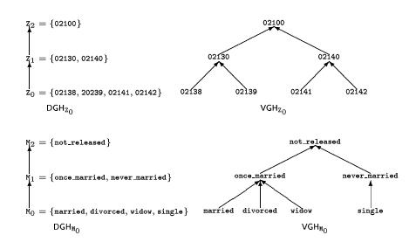
Generalization in Action
slide <number>

Slide 15
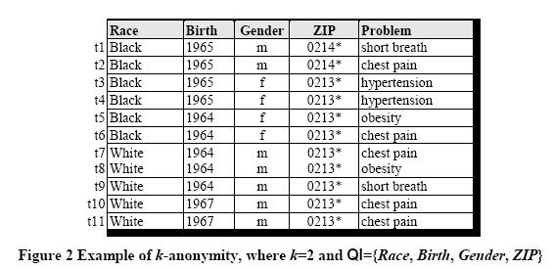
Example of a k-Anonymous Table
slide <number>

Slide 16
Example of Generalization (1)
Released table
External data Source
Name | Birth | Gender | ZIP | Race
Andre | 1964 | m | 02135 | White
Beth | 1964 | f | 55410 | Black
Carol | 1964 | f | 90210 | White
Dan | 1967 | m | 02174 | White
Ellen | 1968 | f | 02237 | White
By linking these 2 tables, you still don’t learn Andre’s problem
slide <number>

Slide 17
Example of Generalization (2)
Microdata
Generalized table
QID |  |  | SA
Zipcode | Age | Sex | Disease
47677 | 29 | F | Ovarian Cancer
47602 | 22 | F | Ovarian Cancer
47678 | 27 | M | Prostate Cancer
47905 | 43 | M | Flu
47909 | 52 | F | Heart Disease
47906 | 47 | M | Heart Disease
QID |  |  | SA
Zipcode | Age | Sex | Disease
476** 476** 476** | 2* 2* 2* | * * * | Ovarian Cancer Ovarian Cancer Prostate Cancer
4790* 4790* 4790* | [43,52] [43,52] [43,52] | * * * | Flu Heart Disease Heart Disease
!!
Released table is 3-anonymous
If the adversary knows Alice’s quasi-identifier (47677, 29, F), he still does not know which of the first 3 records corresponds to Alice’s record
slide <number>

Slide 18
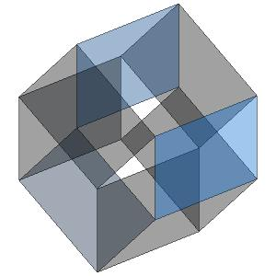
Curse of Dimensionality
[Aggarwal VLDB ‘05]
Generalization fundamentally relies
on spatial locality
  Each record must have k close neighbors
Real-world datasets are very sparse
  Many attributes (dimensions)
    Netflix Prize dataset: 17,000 dimensions
    Amazon customer records: several million dimensions
  “Nearest neighbor” is very far
Projection to low dimensions loses all info ⇒
k-anonymized datasets are useless
slide <number>

Slide 19
HIPAA Privacy Rule
"Under the safe harbor method, covered entities must remove all of a list of 18 enumerated identifiers and have no actual knowledge that the information remaining could be used, alone or in combination, to identify a subject of the information."
“The identifiers that must be removed include direct identifiers, such as name, street address, social security number, as well as other identifiers, such as birth date, admission and discharge dates, and five-digit zip code. The safe harbor requires removal of geographic subdivisions smaller than a State, except for the initial three digits of a zip code if the geographic unit formed by combining all zip codes with the same initial three digits contains more than 20,000 people. In addition, age, if less than 90, gender, ethnicity, and other demographic information not listed may remain in the information. The safe harbor is intended to provide covered entities with a simple, definitive method that does not require much judgment by the covered entity to determine if the information is adequately de-identified."
slide <number>

Slide 20
Two (and a Half) Interpretations
Membership disclosure: Attacker cannot tell that a given person in the dataset
Sensitive attribute disclosure: Attacker cannot tell that a given person has a certain sensitive attribute
Identity disclosure: Attacker cannot tell which record corresponds to a given person
This interpretation is correct, assuming the attacker does not know anything other than quasi-identifiers
But this does not imply any privacy!
Example: k clinical records, all HIV+
slide <number>

Slide 21
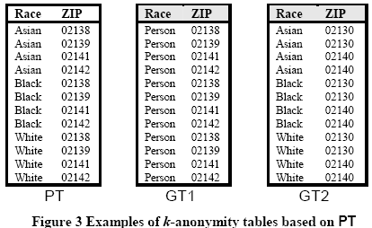
Unsorted Matching Attack
Problem: records appear in the same order in the released table as in the original table
Solution: randomize order before releasing
slide <number>

Slide 22
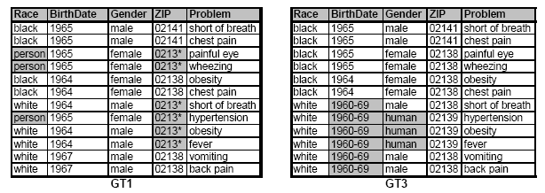
Complementary Release Attack
Different releases of the same private table can be linked together to compromise k-anonymity
slide <number>

Slide 23
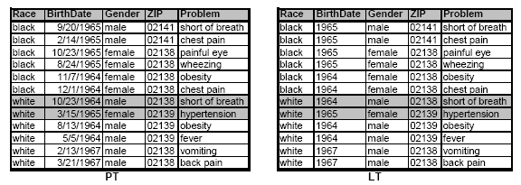
Linking Independent Releases
slide <number>

Slide 24
Attacks on k-Anonymity
k-Anonymity does not provide privacy if
  Sensitive values in an equivalence class lack diversity
  The attacker has background knowledge
A 3-anonymous patient table
Homogeneity attack
Zipcode | Age | Disease
476** | 2* | Heart Disease
476** | 2* | Heart Disease
476** | 2* | Heart Disease
4790* | ≥40 | Flu
4790* | ≥40 | Heart Disease
4790* | ≥40 | Cancer
476** | 3* | Heart Disease
476** | 3* | Cancer
476** | 3* | Cancer
Bob
Zipcode | Age
47678 | 27
Background knowledge attack
Carl
Zipcode | Age
47673 | 36
slide <number>

Slide 25
l-Diversity
[Machanavajjhala et al. ICDE ‘06]
Caucas | 787XX | Flu
Caucas | 787XX | Shingles
Caucas | 787XX | Acne
Caucas | 787XX | Flu
Caucas | 787XX | Acne
Caucas | 787XX | Flu
Asian/AfrAm | 78XXX | Flu
Asian/AfrAm | 78XXX | Flu
Asian/AfrAm | 78XXX | Acne
Asian/AfrAm | 78XXX | Shingles
Asian/AfrAm | 78XXX | Acne
Asian/AfrAm | 78XXX | Flu
Sensitive attributes must be
“diverse” within each
quasi-identifier equivalence class
slide <number>

Slide 26
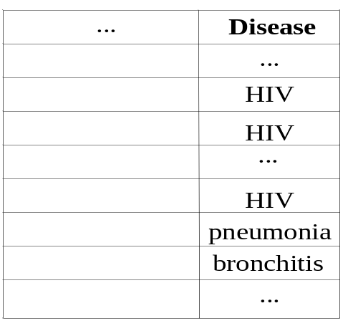
Distinct l-Diversity
Each equivalence class has at least l well-represented sensitive values
Doesn’t prevent probabilistic inference attacks
8 records have HIV
10 records
2 records have other values
slide <number>

Slide 27
Other Versions of l-Diversity
Probabilistic l-diversity
  The frequency of the most frequent value in an equivalence class is bounded by 1/l
Entropy l-diversity
  The entropy of the distribution of sensitive values in each equivalence class is at least log(l)
Recursive (c,l)-diversity
  r₁<c(r_{l}+r_{l+1}+…+r_{m}) where r_{i} is the frequency of the i^{th} most frequent value
  Intuition: the most frequent value does not appear too frequently
slide <number>

Slide 28
Neither Necessary, Nor Sufficient
Original dataset
Anonymization A
Anonymization B
… | Cancer
… | Cancer
… | Cancer
… | Flu
… | Cancer
… | Cancer
… | Cancer
… | Cancer
… | Cancer
… | Cancer
… | Flu
… | Flu
Q1 | Flu
Q1 | Flu
Q1 | Cancer
Q1 | Flu
Q1 | Cancer
Q1 | Cancer
Q2 | Cancer
Q2 | Cancer
Q2 | Cancer
Q2 | Cancer
Q2 | Cancer
Q2 | Cancer
Q1 | Flu
Q1 | Cancer
Q1 | Cancer
Q1 | Cancer
Q1 | Cancer
Q1 | Cancer
Q2 | Cancer
Q2 | Cancer
Q2 | Cancer
Q2 | Cancer
Q2 | Flu
Q2 | Flu
99% cancer ⇒ quasi-identifier group is not “diverse”
…yet anonymized database does not leak anything
50% cancer ⇒ quasi-identifier group is “diverse”
This leaks a ton of information
99% have cancer
slide <number>

Slide 29
Limitations of l-Diversity
Example: sensitive attribute is HIV+ (1%) or HIV- (99%)
  Very different degrees of sensitivity!
l-diversity is unnecessary
  2-diversity is unnecessary for an equivalence class that contains only HIV- records
l-diversity is difficult to achieve
  Suppose there are 10000 records in total
  To have distinct 2-diversity, there can be at most 10000*1%=100 equivalence classes
slide <number>

Slide 30
Skewness Attack
Example: sensitive attribute is HIV+ (1%) or HIV- (99%)
Consider an equivalence class that contains an equal number of HIV+ and HIV- records
  Diverse, but potentially violates privacy!
l-diversity does not differentiate:
  Equivalence class 1: 49 HIV+ and 1 HIV-
  Equivalence class 2: 1 HIV+ and 49 HIV-
l-diversity does not consider overall distribution of sensitive values!
slide <number>

Slide 31
Sensitive Attribute Disclosure
A 3-diverse patient table
Similarity attack
Zipcode | Age | Salary | Disease
476** | 2* | 20K | Gastric Ulcer
476** | 2* | 30K | Gastritis
476** | 2* | 40K | Stomach Cancer
4790* | ≥40 | 50K | Gastritis
4790* | ≥40 | 100K | Flu
4790* | ≥40 | 70K | Bronchitis
476** | 3* | 60K | Bronchitis
476** | 3* | 80K | Pneumonia
476** | 3* | 90K | Stomach Cancer
Bob
Zip | Age
47678 | 27
Conclusion
Bob’s salary is in [20k,40k], which is relatively low
Bob has some stomach-related disease
l-diversity does not consider semantics of sensitive values!
slide <number>

Slide 32
t-Closeness
[Li et al. ICDE ‘07]
Caucas | 787XX | Flu
Caucas | 787XX | Shingles
Caucas | 787XX | Acne
Caucas | 787XX | Flu
Caucas | 787XX | Acne
Caucas | 787XX | Flu
Asian/AfrAm | 78XXX | Flu
Asian/AfrAm | 78XXX | Flu
Asian/AfrAm | 78XXX | Acne
Asian/AfrAm | 78XXX | Shingles
Asian/AfrAm | 78XXX | Acne
Asian/AfrAm | 78XXX | Flu
Distribution of sensitive
attributes within each
quasi-identifier group should
be “close” to their distribution
in the entire original database
Trick question: Why publish
quasi-identifiers at all??
slide <number>

Slide 33
Anonymous, “t-Close” Dataset
Caucas | 787XX | HIV+ | Flu
Asian/AfrAm | 787XX | HIV- | Flu
Asian/AfrAm | 787XX | HIV+ | Shingles
Caucas | 787XX | HIV- | Acne
Caucas | 787XX | HIV- | Shingles
Caucas | 787XX | HIV- | Acne
This is k-anonymous,
l-diverse and t-close…
…so secure, right?
slide <number>

Slide 34

What Does Attacker Know?
Bob is Caucasian and
I heard he was
admitted to hospital
with flu…
Caucas | 787XX | HIV+ | Flu
Asian/AfrAm | 787XX | HIV- | Flu
Asian/AfrAm | 787XX | HIV+ | Shingles
Caucas | 787XX | HIV- | Acne
Caucas | 787XX | HIV- | Shingles
Caucas | 787XX | HIV- | Acne
This is against the rules!
“flu” is not a quasi-identifier
Yes… and this is yet another
problem with k-anonymity
slide <number>

Slide 35
AOL Privacy Debacle
In August 2006, AOL released anonymized search query logs
  657K users, 20M queries over 3 months (March-May)
Opposing goals
  Analyze data for research purposes, provide better services for users and advertisers
  Protect privacy of AOL users
    Government laws and regulations
    Search queries may reveal income, evaluations, intentions to acquire goods and services, etc.
slide <number>

Slide 36
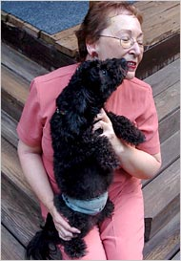
AOL User 4417749
AOL query logs have the form
<AnonID, Query, QueryTime, ItemRank, ClickURL>
  ClickURL is the truncated URL
NY Times re-identified AnonID 4417749
  Sample queries: “numb fingers”, “60 single men”, “dog that urinates on everything”, “landscapers in Lilburn, GA”, several people with the last name Arnold
    Lilburn area has only 14 citizens with the last name Arnold
  NYT contacts the 14 citizens, finds out AOL User 4417749 is 62-year-old Thelma Arnold
slide <number>

Slide 37
k-Anonymity Considered Harmful
Syntactic
  Focuses on data transformation, not on what can be learned from the anonymized dataset
  “k-anonymous” dataset can leak sensitive information
“Quasi-identifier” fallacy
  Assumes a priori that attacker will not
  know certain information about his target
Relies on locality
  Destroys utility of many real-world datasets
slide <number>

